Slide 1
Chapter 3: Paul Ammann and Jeff Offutt, Introduction to Software Testing-Cambridge University Press (2017)
Software Testing
Test Automation

Slide 2
Test Automation
The use of software to control the execution of tests, the comparison of actual outcomes to predicted outcomes, the setting up of test preconditions, and other test control and test reporting functions
Reduces cost
Reduces human error
Reduces variance in test quality from different individuals
Significantly reduces the cost of regression testing

Slide 3
Software Testability
The degree to which a system or component facilitates the establishment of test criteria and the performance of tests to determine whether those criteria have been met
Plainly speaking – how hard it is to find faults in the software
Testability is dominated by two practical problems
How to provide the test values to the software
How to observe the results of test execution

Slide 4
Observability and Controllability
Observability
Software that affects hardware devices, databases, or remote files have low observability
Controllability
Easy to control software with inputs from keyboards
Inputs from hardware sensors or distributed software is harder
Data abstraction reduces controllability and observability
How easy it is to observe the behavior of a program in terms of its outputs, effects on the environment and other hardware and software components
How easy it is to provide a program with the needed inputs, in terms of values, operations, and behaviors

Slide 5
Components of a Test Case
A test case is a multipart artifact with a definite structure
Test case values
Expected results
A test oracle uses expected results to decide whether a test passed or failed
The input values needed to complete an execution of the software under test
The result that will be produced by the test if the software behaves as expected

Slide 6
Putting Tests Together
Test case
Test set
Executable test script
The test case values, prefix values, postfix values, and expected results necessary for a complete execution and evaluation of the software under test
A set of test cases
A test case that is prepared in a form to be executed automatically on the test software and produce a report

Slide 7
Test Automation Framework
A set of assumptions, concepts, and tools that support test automation

Slide 8
JUnit?
Open source Java testing framework used to write and run repeatable automated tests
JUnit is open source (junit.org)
A structure for writing test drivers
JUnit features include:
Assertions for testing expected results
Test features for sharing common test data
Test suites for easily organizing and running tests
Graphical and textual test runners
JUnit is widely used in industry
JUnit can be used as stand alone Java programs (from the command line) or within an IDE such as Eclipse

Slide 9
Features of JUnit Test Framework
JUnit test framework provides the following important features :
Fixtures
Test suites
Test runners
JUnit classes

Slide 10
Fixtures
A test fixture is a fixed state of a set of objects used as a baseline for running tests.
The purpose of a test fixture is to ensure that there is a well known and the fixed
environment in which tests are run so that results are repeatable.
setUp() method, which runs before every test invocation. i.e we will use @Before
annotation
tearDown() method, which runs after every test method. i.e we will use @After
annotation
- Example: create a database connection.
Likewise, at the end of each test case, there may be some repeated tasks.
- Example: to clean up once test execution is over.
JUnit provides annotations that help in setup and teardown. It ensures that resources
are released, and the test system is in a ready state for next test case.

Slide 11
Annotations
Annotations is a special form of syntactic meta-data that can be added to Java source code for better code readability and structure
Some basic annotations:
@Before
This annotation is used if you want to execute some statement such as preconditions before each test case.
@BeforeClass
This annotation is used if you want to execute some statements before all the test cases for e.g. test connection must be executed before all the test cases.
@After
This annotation can be used if you want to execute some statements after each Test Case for e.g resetting variables, deleting temporary files ,variables, etc.

Slide 12
Annotations
@AfterClass
This annotation can be used if you want to execute some statements after all test cases for e.g. Releasing resources after executing all test cases.
@Ignores
This annotation can be used if you want to ignore some statements during test execution for e.g. disabling some test cases during test execution.
@Test(timeout=500)
This annotation can be used if you want to set some timeout during test execution for e.g. if you are working under some SLA (Service level agreement), and tests need to be completed within some specified time.
@Test(expected=IllegalArgumentException.class)
This annotation can be used if you want to handle some exception during test execution. For, e.g., if you want to check whether a particular method is throwing specified exception or not.

Slide 13
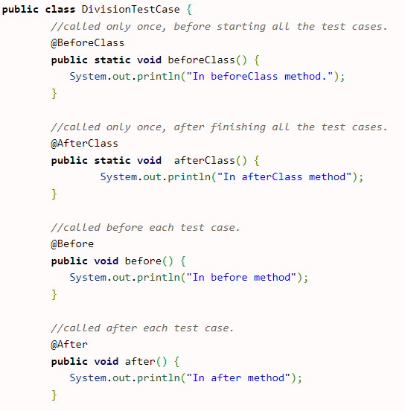
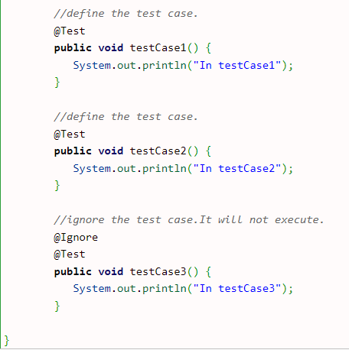
Annotation Example

Slide 14
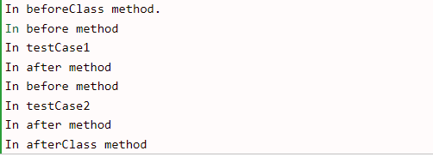
Annotation Example
Output:

Slide 15
Assertions:
Assert is a method useful in determining Pass or Fail status of a test case, The assert methods are provided by the class org. junit. Assert which extends java. ... Object class. There are various types of assertions like Boolean, Null, Identical etc
Assert Equals
If you want to test equality of two objects, you have the following methods
assertEquals(expected, actual)
It will return true if: expected.equals( actual ) returns true.
Example:

Slide 16
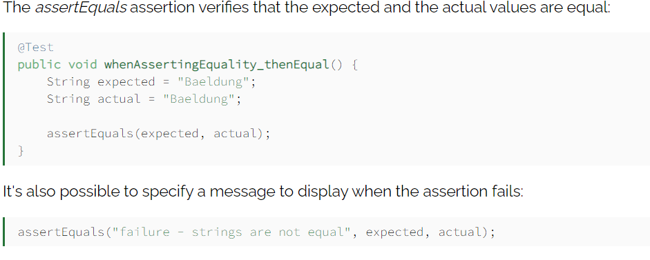
Assertions
Example:

Slide 17
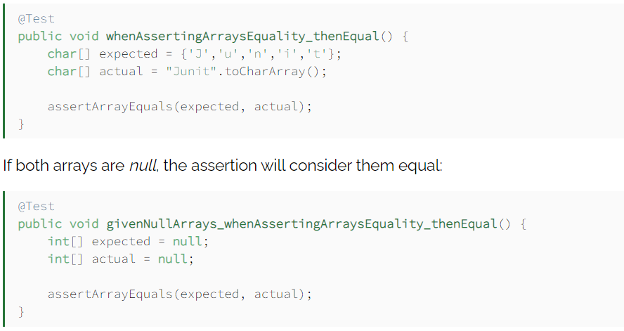
Assertions
Assert Array Equals
If we want to assert that two arrays are equals, we can use the assertArrayEquals:
assertArrayEquals(expected, actual)
Example:

Slide 18
Assertions

Slide 19
JUnit Tests
JUnit can be used to test …
… an entire object
… part of an object – a method or some interacting methods
… interaction between several objects
It is primarily intended for unit and integration testing, not system testing
Each test is embedded into one test method
A test class contains one or more test methods
Test classes include :
A collection of test methods
Methods to set up the state before and update the state after each test and before and after all tests
Get started at junit.org

Slide 20
Writing Tests for JUnit
Need to use the methods of the junit.framework.assert class
javadoc gives a complete description of its capabilities
Each test method checks a condition (assertion) and reports to the test runner whether the test failed or succeeded
The test runner uses the result to report to the user (in command line mode) or update the display (in an IDE)
All of the methods return void
A few representative methods of junit.framework.assert
assertTrue (boolean)
assertTrue (String, boolean)
fail (String)

Slide 21
JUnit Test Fixtures
A test fixture is the state of the test
Objects and variables that are used by more than one test
Initializations (prefix values)
Reset values (postfix values)
Different tests can use the objects without sharing the state
Objects used in test fixtures should be declared as instance variables
They should be initialized in a @Before method
Can be deallocated or reset in an @After method

Slide 22
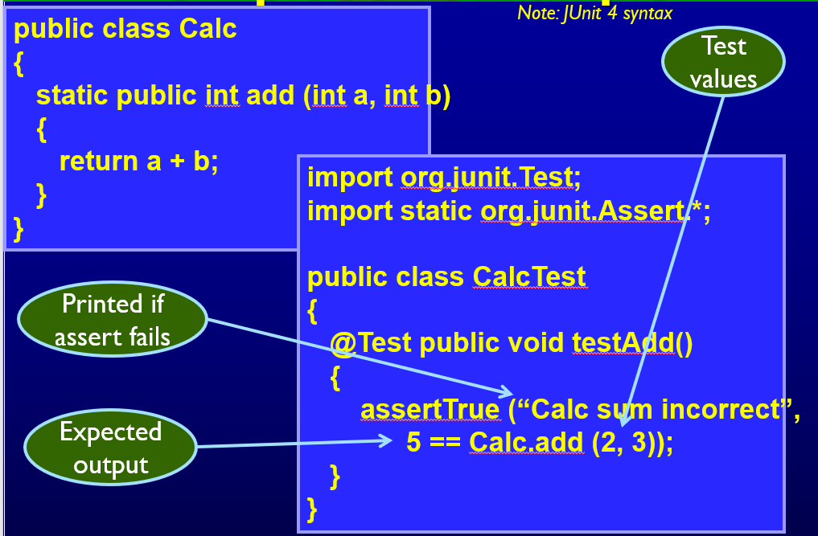
Simple JUnit Example

Slide 23
Testing the Min Class
import java.util.*;
public class Min
{
/**
* Returns the mininum element in a list
* @param list Comparable list of elements to search
* @return the minimum element in the list
* @throws NullPointerException if list is null or
* if any list elements are null
* @throws ClassCastException if list elements are not mutually comparable
* @throws IllegalArgumentException if list is empty
*/
…
}
public static <T extends Comparable<? super T>> T min (List<? extends T> list)
{
if (list.size() == 0)
{
throw new IllegalArgumentException ("Min.min");
}
Iterator<? extends T> itr = list.iterator();
T result = itr.next();
if (result == null) throw new NullPointerException ("Min.min");
while (itr.hasNext())
{ // throws NPE, CCE as needed
T comp = itr.next();
if (comp.compareTo (result) < 0)
{
result = comp;
} }
return result;
}

Slide 24
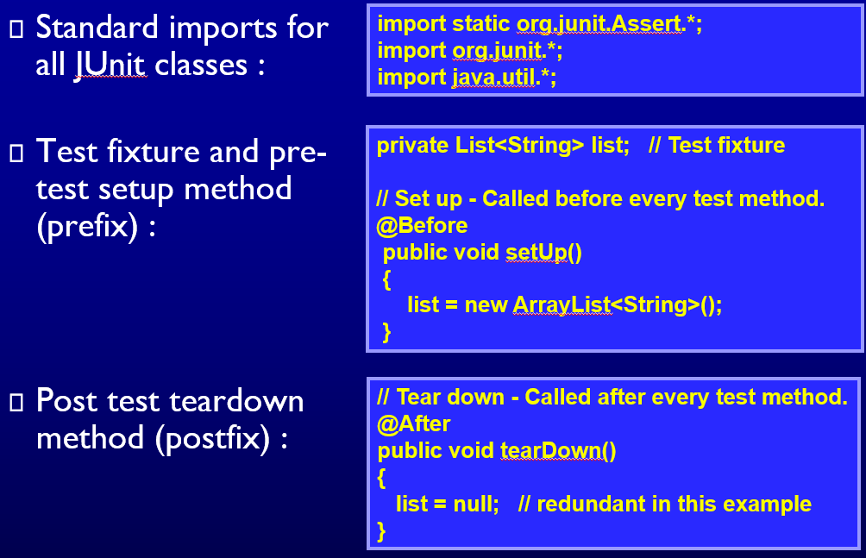
MinTest Class

Slide 25
Data-Driven Tests
Problem : Testing a function multiple times with similar values
How to avoid test code bloat?
Simple example : Adding two numbers
Adding a given pair of numbers is just like adding any other pair
You really only want to write one test
Data-driven unit tests call a constructor for each collection of test values
Same tests are then run on each set of data values
Collection of data values defined by method tagged with @Parameters annotation

Slide 26
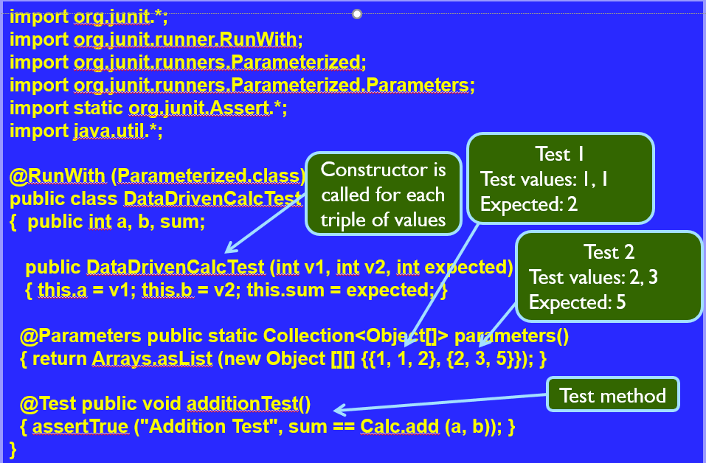
Example JUnit Data-Driven Unit Test

Slide 27
Tests with Parameters: JUnit Theories
Unit tests can have actual parameters
So far, we’ve only seen parameterless test methods
Contract model: Assume, Act, Assert
Assumptions (preconditions) limit values appropriately
Action performs activity under scrutiny
Assertions (postconditions) check result
@Theory public void removeThenAddDoesNotChangeSet (
Set<String> someSet, String str) { // Parameters!
assumeTrue (someSet != null) // Assume
assumeTrue (someSet.contains (str)) ; // Assume
Set<String> copy = new HashSet<String>(someSet); // Act
copy.remove (str);
copy.add (str);
assertTrue (someSet.equals (copy)); // Assert
}

Slide 28
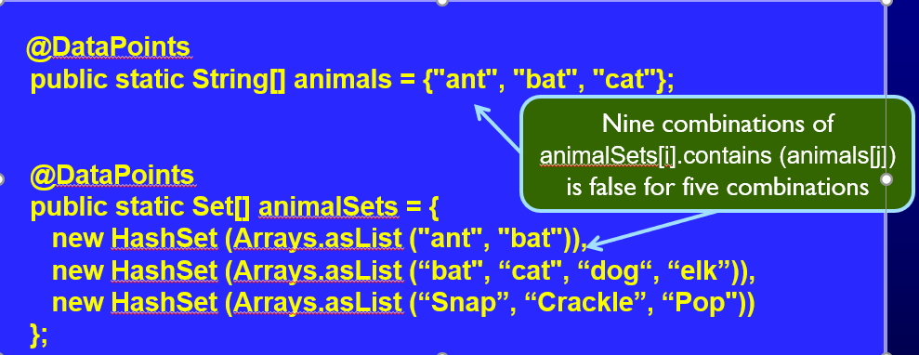
Question: Where Do The Data Values Come From?
Answer:
All combinations of values from @DataPoints annotations where assume clause is true
Four (of nine) combinations in this particular case
Note: @DataPoints format is an array

Slide 29
Thank you

